Slide 1


Using Deep Learning Neural Networks and Candlestick Chart Representation to Predict Stock Market
Master Thesis Defense
Department Computer Science and Engineering.
Yuan Ze University, Taiwan.
Advisor : Yu-Yen Ou
Tuesday, July, 19th, 2018
Student : Rosdyana Mangir Irawan Kusuma

Slide 2
OUTLINE
01
INTRODUCTION
02
RELATED WORK
03
METHODOLOGY
04
RESULT
05
CONCLUSION and FUTUREWORK

Slide 3
INTRODUCTION
1

Slide 4
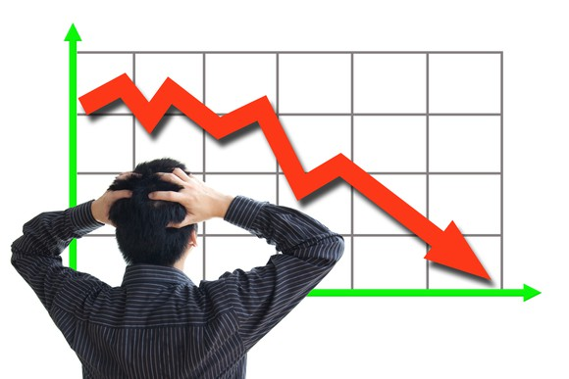
Introduction
A stock market, equity market or share market is the aggregation of buyers and sellers of stocks, which represent ownership claims on businesses.
Stock market crash : Panic of 1907, Wall Street Crash of 1929, Black Monday 1987, Crash of 2008-2009.
One of the visualization aid for trader to read movement price in stock market is Candlestick Chart.
Notes:
Introduction of stock market and candlestick chart

Slide 5
Motivations
Stock market prediction is a challenging problem:
Company news and performance
Industry performance
Economic factor
Social media sentiment
Investor sentiment
Helps trader to enhance their information about stock market movements.
Perform good prediction to get more benefit in stock market trading.
Notes:
Challenging because a lot factors affect the stock price movements

Slide 6
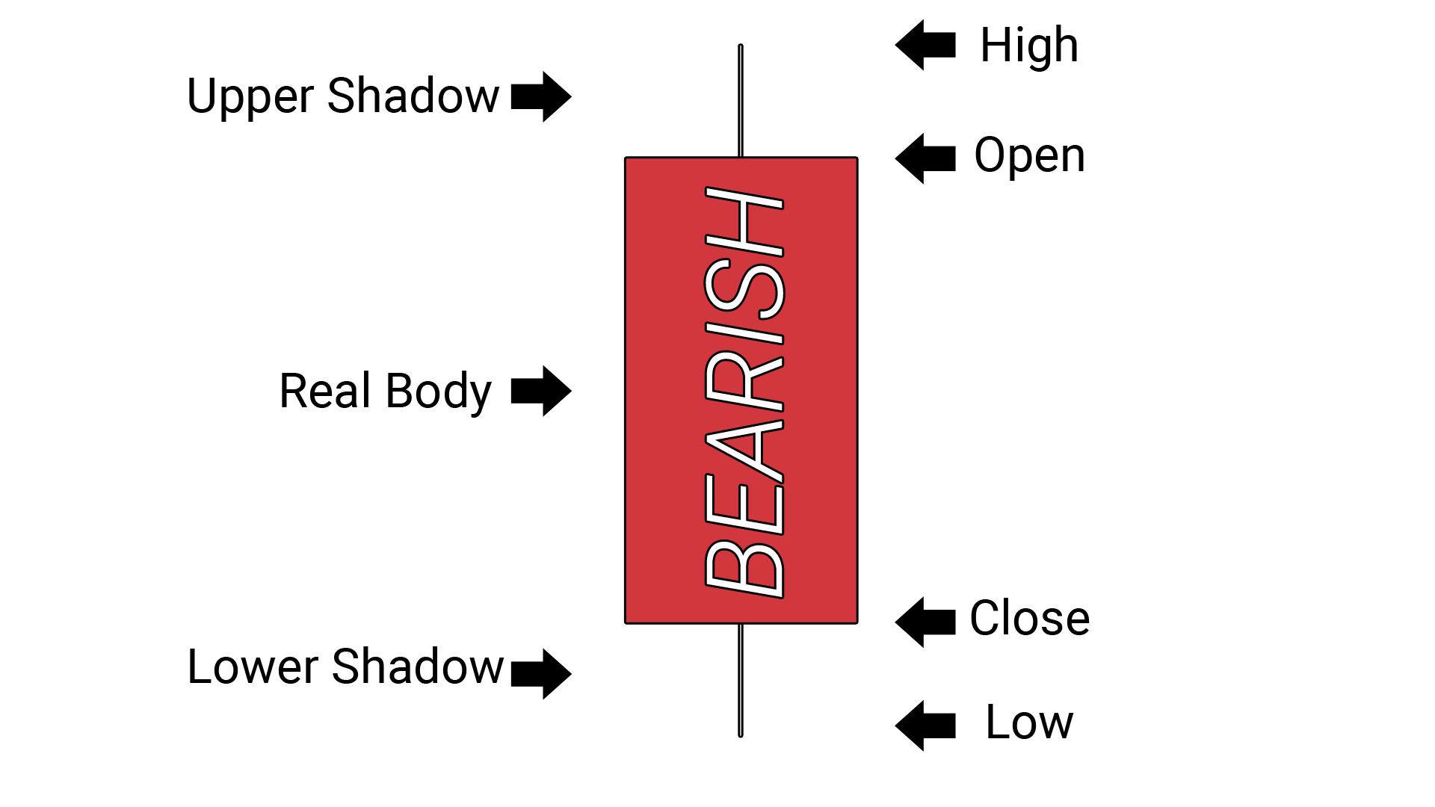
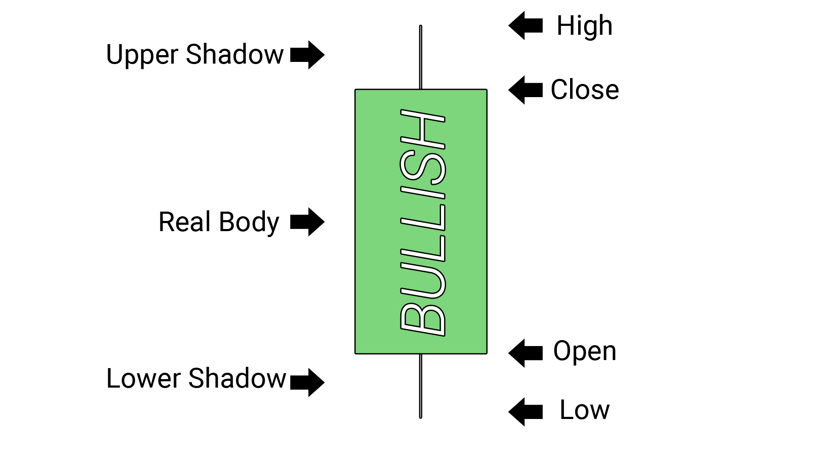
Candlestick Chart
A style of financial chart used to describe price movements of stock market.
Contains open, high, low and close price value.
Candlestick pattern is a movement in prices shown graphically on a candlestick chart that some believe can predict a particular market movement.
Currently there are 41 recognised patterns.

Slide 7
Candlestick Patterns
Identify the end of strongly up trending market:
Bullish Engulfing
shooting star
evening star
bearish tweezer
Identify the end of strongly down trending market
Bearish engulfing
Hammer
Morning star
Bullish tweezer
Bullish Engulfing
Evening Star
Shooting Star
Bearish tweezer
Bearish Engulfing
Morning Star
Hammer
Bullish tweezer
Notes:
Bearish engulfing : identify the end of strongly up trending market
Bullish engulfing : identify the end of strongly down trending market
Shooting start : identify the end of strongly up trending market
Hammer : identify the end of strongly down trending
Evening star : identify the end of strongly up trending market
Morning Start : identify the end of strongly down trending
Bearish tweezer : identify the end of strongly up trending market
Bullish tweezer : identify the end of strongly down trending

Slide 8
Historical Stock Market Data
Name | Description
Open Price | The first price in daily activity of the stock market that is noted when the stock market opens in the specified period.
Close Price | The final price at which a security is traded on a given trading day.
High Price | Highest price at which a stock traded during the course of the day.
Low Price | Lowest price at which a stock trades over the course of a trading day.
Volume | the number of shares or contracts traded in a security or an entire market during a given period.

Slide 9

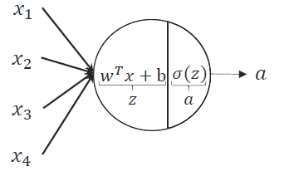
Deep Learning
Using brain-inspired mechanics to achieve brain-like function
A Neuron in our neuron network
A Neuron in our brain
Notes:
But neurons in our brain are far more complex, and neural networks aren’t accurate representations of the brain
In recent years, deep learning show great potential in many fields : image classification, natural language processing, and speech recognition

Slide 10
Traditional Learning Approach vs Deep Learning Approach
Traditional Learning architecture:
Hand-design feature extraction
Trainable classifier
Input (Image, Text,..)
Object class
Deep Learning architecture:
Layer 1
Layer N
Simple classifier
...
Object class
Input (Image, Text,..)

Slide 11
RELATED WORK

Slide 12
Related Work
Author | Idea and Method | Result | Compare
do Prado, Ferneda et al. 2013 | Used the Candlestick Chart to learn the candlestick pattern in Brazilian stock market. | Studied 16 candlestick patterns, concluded 9 patterns appeared with a frequency higher than 1%. Pattern with greatest predictive ability was Harami-Bullish. | No
Tsai and Quan 2014 | Utilized the candlestick chart to combine with 7 different wavelet-based texture to analyse the candlestick chart. | Via content-based image retrieval (CIBR) with 63 % accuracy. | No
Patel, Shah et al. 2015 | Added 10 technical analysis in feature set to perform stock market prediction using 4 algorithm (ANN, SVM, random forest, naive-bayes). | Highest result by naive-bayes with average 90 % accuracy. | Yes
Khaidem, Saha et al. 2016 | Using historical trading data from Apple, Samsung and GE to predict stock market using random forest with adding Relative Strength Index (RSI) | Average result is 89 % accuracy. | Yes
Hu, Hu et al. 2017 | Used the candlestick chart to build a decision-making system in stock market investment. They used the convolutional encoder to learn the patterns contained in the candlestick chart. | their portfolio achieved the highest returns: Total (215.4%), daily (16.7%), monthly (16.6%), yearly (11.8%) in 2000 trading days. | No
Zhang, Zhang et al. 2018 | Combine trading data with sentiment from social media and financial news in Hong Kong stock market. | Highest result 61 % accuracy. | Yes

Slide 13
METHODOLOGY

Slide 14


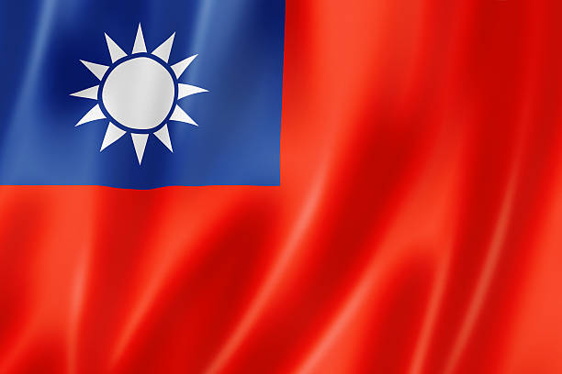

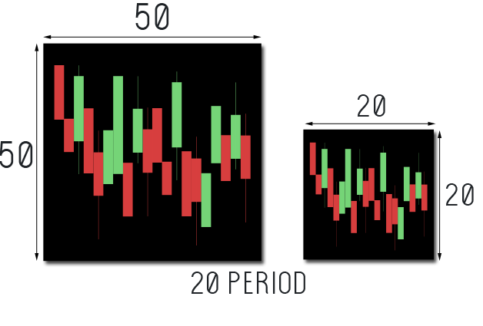
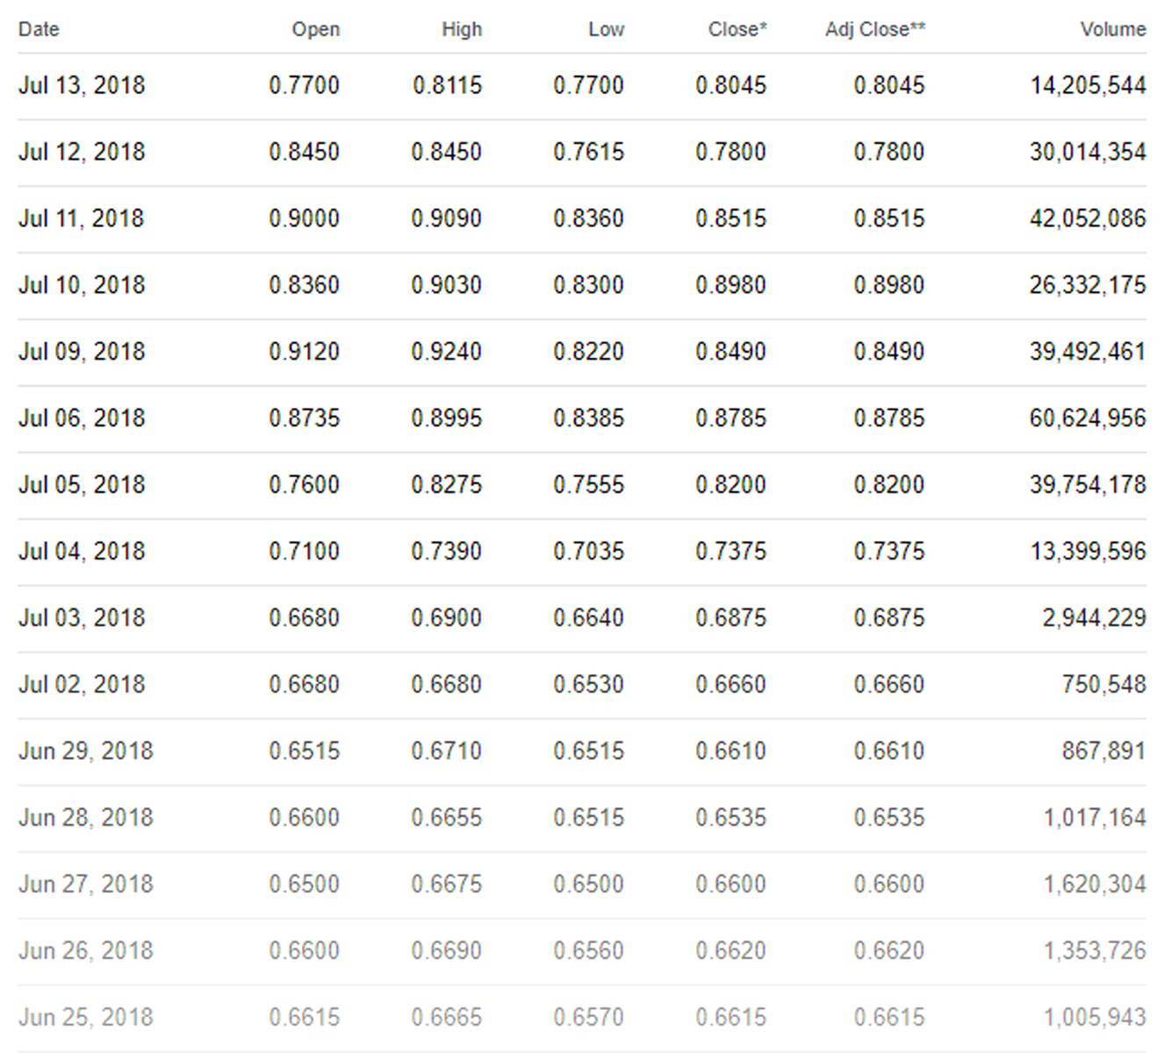
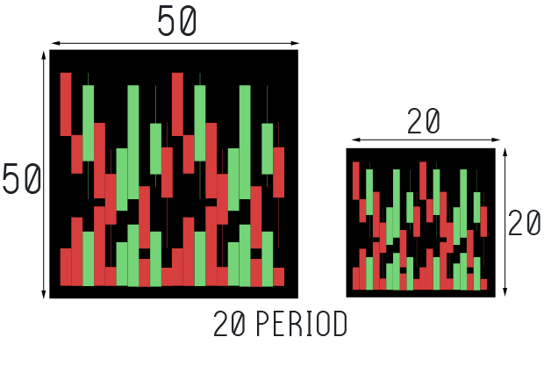
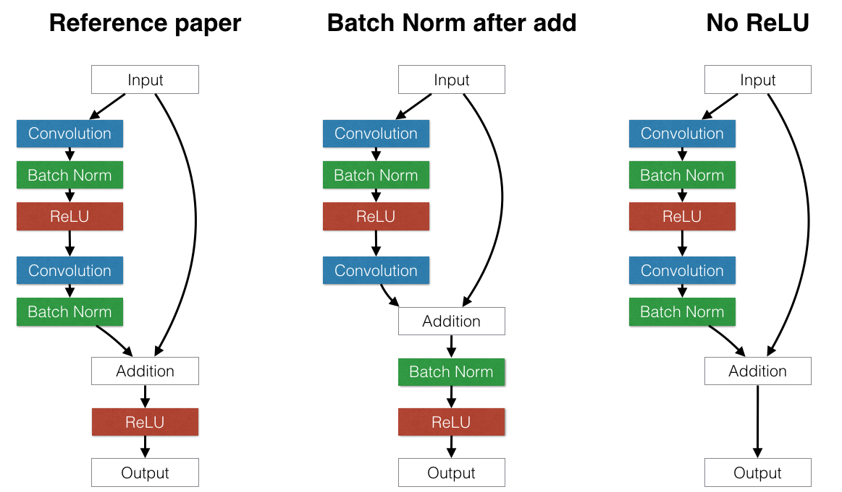

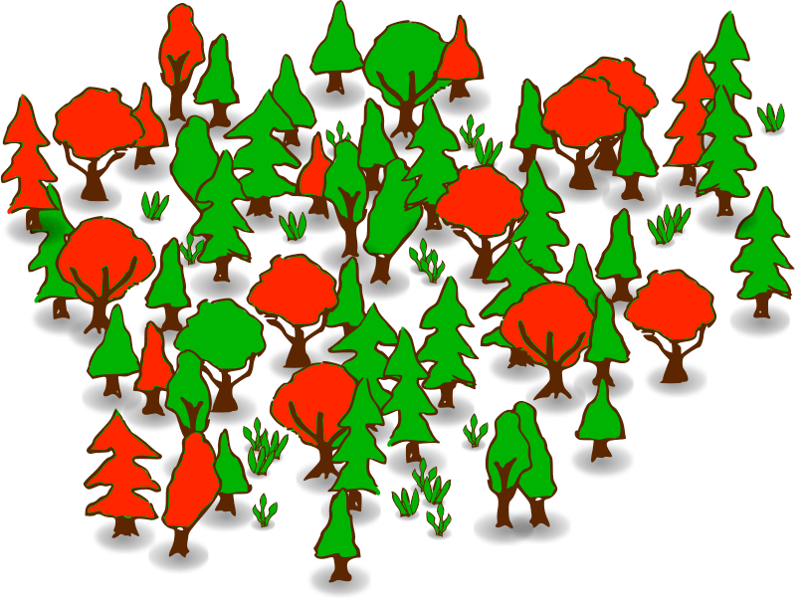

Methodology Design
Data Collection
Training : 2000-01-01 - 2016-12-31
Testing : 2017-01-01 - 2018-06-14
Name | Training | Testing | Independent
TW50 | 198866 | 14756 | 348
ID10 | 34458 | 3692 | 348
Independent : 2017-01-01 - 2018-06-14
Data Preprocessing
 | 5 Periods |  |  | 10 Periods |  |  | 20 Periods
Name | Training | Testing | Independent | Training | Testing | Independent | Training | Testing | Independent
TW50 | 198569 | 17164 | 342 | 198151 | 16950 | 337 | 197819 | 16414 | 327
ID10 | 34350 | 3611 | 342 | 34323 | 3582 | 337 | 34233 | 3482 | 327
Convert to
Candlestick chart
Sliding Window
Modern Neural Network
UP
DOWN
VGG Network
ResNet Network
Convolutional Neural Network
Traditional Neural Network
Final
Model
Evaluation
Random Forest
K-Nearest Neighbor

Slide 15
Top 10 - Taiwan50 Company List
No | Name | Ticker | Volume | 52 Week Range
1 | Advanced Semiconductor Engineering | 2311.TW | 86,190,484 | 44.15 - 46.10
2 | AU Optronics | 2409.TW | 43,954,252 | 11.60 - 14.45
3 | Hon Hai Precision Industry | 2317.TW | 36,224,415 | 79.50 - 122.50
4 | China Development Financial Holdings | 2883.TW | 35,958,075 | 8.71 - 11.70
5 | Taiwan Semiconductor Manufacturing | 2330.TW | 29,716,311 | 210.00 - 270.50
6 | Siliconware Precision Industries | 2325.TW | 28,090,566 | 50.90 - 51.10
7 | Innolux | 3481.TW | 27,146,129 | 10.80 - 16.30
8 | E.Sun Financial Holding | 2884.TW | 20,970,569 | 17.70 - 21.9
9 | United Microelectronics | 2303.TW | 20,428,290 | 13.40 - 18.65
10 | Taiwan Cement | 1101.TW | 19,271,854 | 33.35 - 47.30
Full list : http://bit.ly/TAIWAN50COMPANIES

Slide 16
Indonesia 10 Company List
No | Name | Ticker | Volume | 52 Week Range
1 | Perusahaan Perseroan (Persero) PT Telekomunikasi Indonesia Tbk | TLKM.JK | 120,850,800 | 3,250.00 - 4,840.00
2 | PT Bank Rakyat Indonesia (Persero) Tbk | BBRI.JK | 101,906,100 | 2,720.00 - 3,920.00
3 | PT Bank Mandiri (Persero) Tbk | BMRI.JK | 35,536,800 | 6,250.00 - 9,050.00
4 | PT Bank Rakyat Indonesia (Persero) Tbk | ASII.JK | 27,647,800 | 6,250.00 - 8,850.00
5 | PT Bank Negara Indonesia (Persero) Tbk | BBNI.JK | 25,450,600 | 6,750.00 - 10,175.00
6 | PT Bank Central Asia Tbk | BBCA.JK | 14,787,200 | 18,100.00 - 24,700.00
7 | PT Bank Central Asia Tbk | HMSP.JK | 12,466,700 | 3,230.00 - 5,550.00
8 | PT United Tractors Tbk | UNTR.JK | 4,970,000 | 27,625.00 - 40,500.00
9 | PT Unilever Indonesia Tbk | UNVR.JK | 1,317,800 | 43,875.00 - 58,100.00
10 | PT Gudang Garam Tbk | GGRM.JK | 413,900 | 61,925.00 - 86,400.00

Slide 17
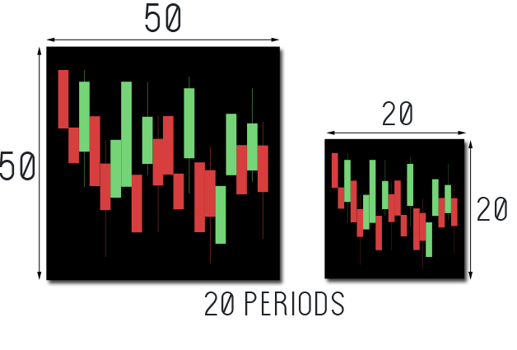

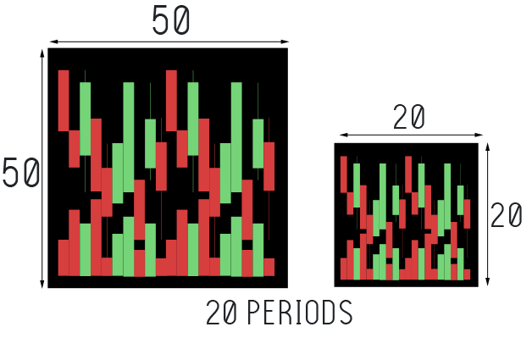
From Historical Trading Data To Candlestick Chart
CANDLESTICK CHART
Name | Training | Testing | Independent
TW50 | 198866 | 14756 | 348
ID10 | 34458 | 3692 | 348
HISTORICAL TRADING DATA

Slide 18
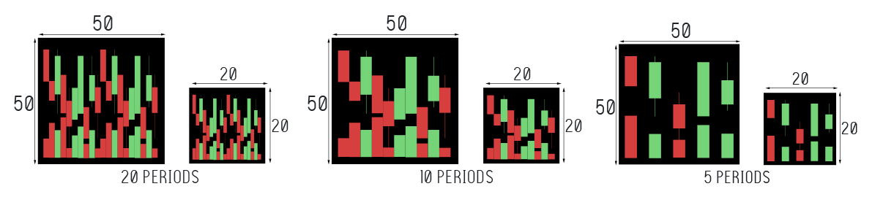
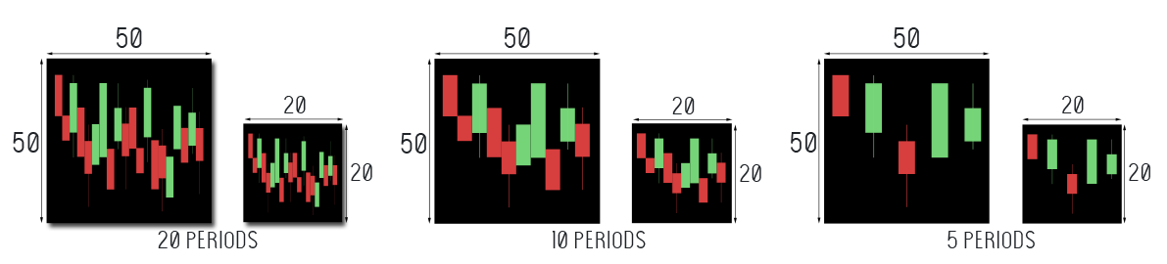
Our Candlestick Chart

Slide 19
Sliding Window of Trading days Period
W1
W2
D1
D2
D3
D4
D5
D1
D2
D3
D4
D5
CANDLESTICK DATA
LABEL
CANDLESTICK DATA
LABEL
CANDLESTICK DATA
LABEL
CANDLESTICK DATA
LABEL
CANDLESTICK DATA
LABEL

Slide 20
Our Dataset
Training and Testing Dataset
 | 5 Periods |  | 10 Periods |  | 20 Periods
Name | Training | Testing | Training | Testing | Training | Testing
TW50 | 198569 | 17164 | 198151 | 16950 | 197819 | 16414
ID10 | 34350 | 3611 | 34323 | 3582 | 34233 | 3482
Independent Dataset
Data | 5 Periods | 10 Periods | 20 Periods
0050.TW | 342 | 337 | 327
^JKSE | 342 | 337 | 327

Slide 21
Positive And Negative Statistic - TW50

Slide 22
Positive And Negative Statistic - ID10

Slide 23
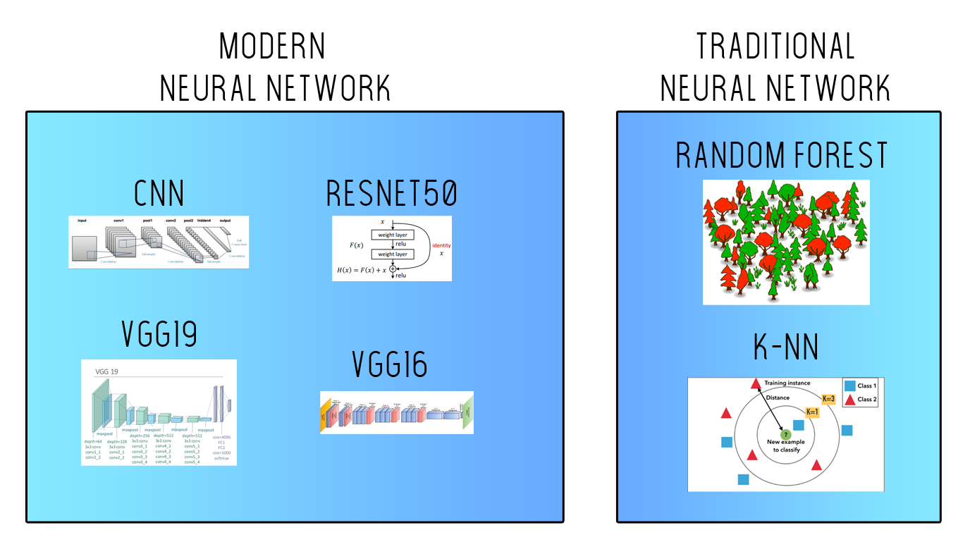
Learning Algorithm

Slide 24
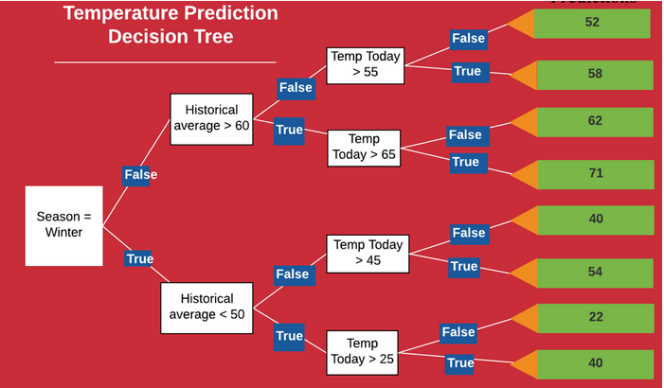
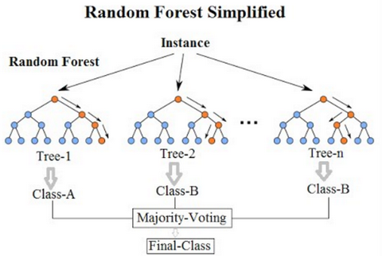
Random Forest
Decision trees use a tree-like model of decisions and their possible consequences.
Random Forest classifier is a classifier with Consist of many decision trees. Each decision tree in the forest considers a random subset of features
https://medium.com/@williamkoehrsen/random-forest-simple-explanation-377895a60d2d
Notes:
Decision tree : uses a tree-like model of decisions and their possible consequences. It only contains conditional control statements
Random Forest consist of many decision trees. Each decision tree in the forest considers a random subset of features when forming questions and only has access to a random set of the training data points.This increases diversity in the forest leading to more robust overall predictions and the name ‘random forest.’
Reference (https://medium.com/@williamkoehrsen/random-forest-simple-explanation-377895a60d2d)

Slide 25
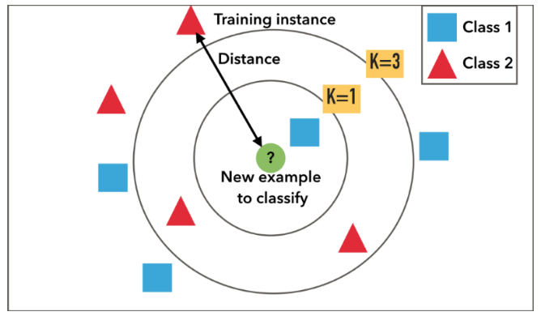
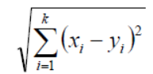
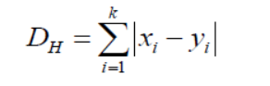
K-Nearest Neighbors
A non-parametric method ,lazy learning algorithm that categorizes an input by using its k nearest neighbors
Separate the data points into several classes to predict the classification of a new point
Determining a neighbor can be performed using many different notions of distance, with the most common being Euclidean and Hamming distance
Euclidean distance
Harming distance
https://medium.com/@adi.bronshtein/a-quick-introduction-to-k-nearest-neighbors-algorithm-62214cea29c7
Notes:
KNN is a non-parametric, lazy learning algorithm. Its purpose is to use a database in which the data points are separated into several classes to predict the classification of a new sample point.
Explain about above pict: Example of k-NN classification. The test sample (green circle) should be classified either to the first class of blue squares or to the second class of red triangles. If k = 3 (solid line circle) it is assigned to the second class because there are 2 triangles and only 1 square inside the inner circle. If k = 1 it is assigned to the first class (1 squares vs. 0 triangles inside the outer circle)

Slide 26
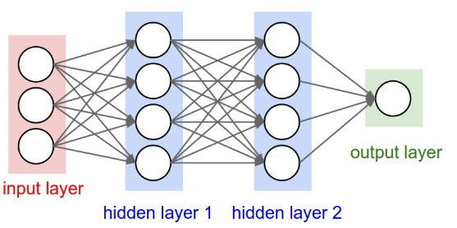
Convolution Neural Networks
Neural Network:
Modeled as collections of neurons that are connected in an acyclic graph
outputs of some neurons can become inputs to other neurons
Receive an input, and transform it through a series of hidden layers.
Each neuron is fully connected to all neurons in previous layer.
Last full-connected layer is called the “output layer” (represents the class scores in classification task)
https://www.pyimagesearch.com/wp-content/uploads/2016/08/simple_neural_network_header-768x377.jpg
Notes:
Neural Networks are modeled as collections of neurons that are connected in an acyclic graph. In other words, the outputs of some neurons can become inputs to other neurons. Neural Networks receive an input (a single vector), and transform it through a series of hidden layers. Each hidden layer is made up of a set of neurons, where each neuron is fully connected to all neurons in the previous layer. The last fully-connected layer is called the “output layer” and in classification settings it represents the class scores (the examples in image is A 3-layer neural network with three inputs, two hidden layers of 4 neurons each and one output layer)

Slide 27
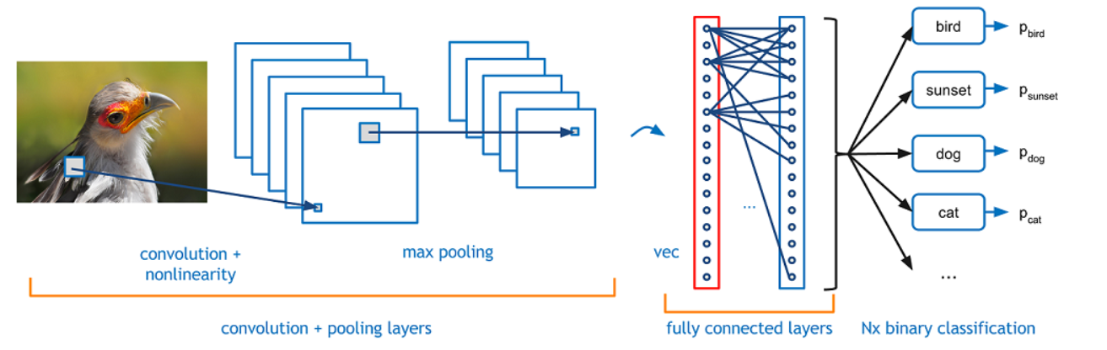
Convolution Neural Networks
CNN Configuration
Input
Conv2D-32 ReLU
max-pooling
Conv2D-48 ReLU
max-pooling
Dropout
Conv2D-64 ReLU
max-pooling
Conv2D-96 ReLU
max-pooling
Dropout
Flatten
Dense-256
Dropout
Dense-2
Convolution Neural Networks (ConvNets)
A class of deep, feed-forward artificial neural networks.
Neurons that have learnable weights and biases
The hidden layers: convolutional layers, pooling layers, fully connected layers and normalization layers.
The features are learned directly by the CNN.
CNNs can be retrained for new recognition tasks
https://adeshpande3.github.io/assets/Cover.png
Notes:
Convolutional Neural Networks are very similar to ordinary Neural Networks. they are made up of neurons that have learnable weights and biases
he hidden layers of a CNN typically consist of convolutional layers, pooling layers, fully connected layers and normalization layers
CNNs eliminate the need for manual feature extraction—the features are learned directly by the CNN
CNNs can be retrained for new recognition tasks, enabling you to build on pre-existing networks
Thoses figures show example for recognization task.
(Can add your CNN architecture here)

Slide 28
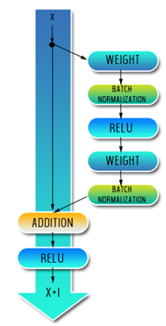
RESIDUAL NETWORK
Developed by (He, Zhang et al. 2016) was the winner of ILSVRC 2015.
It features special skip connections and a heavy use of batch normalization.
ResNets are currently by far state of the art Convolutional Neural Network models

Slide 29
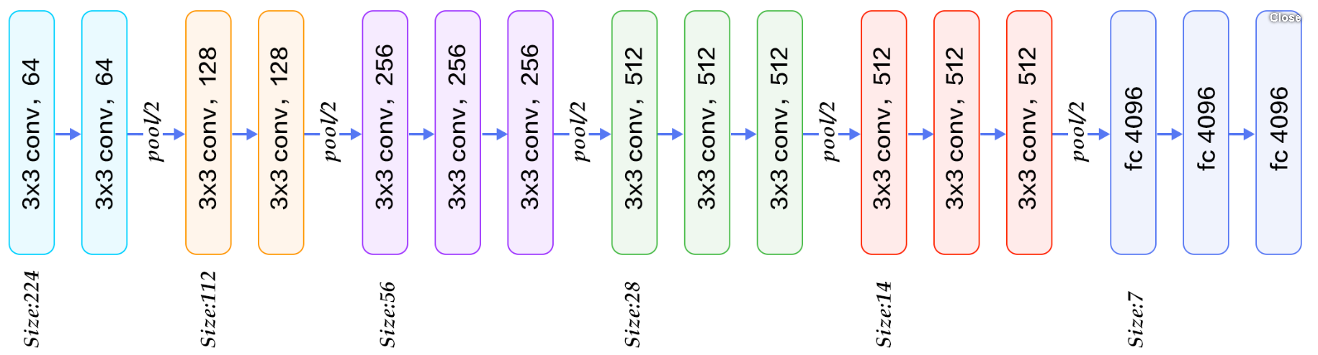
Visual Geometry Group Network
The VGG network architecture was introduced by (Simonyan and Zisserman 2014).
using only 3x3 convolutional layers stacked on top of each other in increasing depth.
Reducing volume size is handled by max pooling
fc 4096
https://www.quora.com/What-is-the-VGG-neural-network

Slide 30
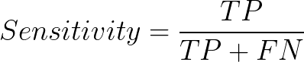
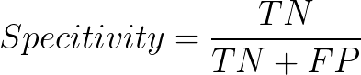
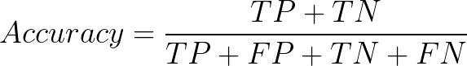
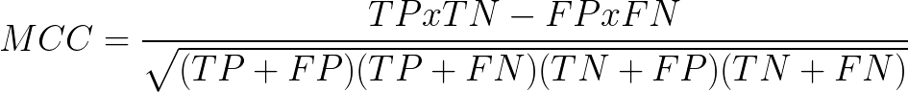
Performance Evaluation
FN
TP
FP
TN

Slide 31
TESTING RESULT
TW50 and ID10

Slide 32
Testing Result TW50
 | Classifier | Periods | Dimension | Sensitivity | Specificity | Accuracy | MCC
With Volume | CNN | 5 | 50 | 83.2 | 83.8 | 83.5 | 0.67
 | CNN | 10 | 50 | 88.6 | 87.3 | 88.0 | 0.758
 | CNN | 20 | 50 | 91.6 | 91.3 | 91.5 | 0.827
 | CNN | 5 | 20 | 83.9 | 82.7 | 83.3 | 0.666
 | Random Forest | 10 | 20 | 87.0 | 88.3 | 87.6 | 0.751
 | CNN | 20 | 20 | 90.8 | 90.2 | 90.6 | 0.808
Without Volume | CNN | 5 | 50 | 83.6 | 85.1 | 84.4 | 0.687
 | CNN | 10 | 50 | 89.2 | 88.1 | 88.7 | 0.773
 | CNN | 20 | 50 | 93.3 | 90.7 | 92.2 | 0.84
 | CNN | 5 | 20 | 84.8 | 83.0 | 83.9 | 0.678
 | CNN | 10 | 20 | 88.0 | 88.2 | 88.1 | 0.761
 | CNN | 20 | 20 | 81.7 | 91.4 | 91.0 | 0.817

Slide 33
Testing Result ID10
 | Classifier | Periods | Dimension | Sensitivity | Specificity | Accuracy | MCC
With Volume | ResNet50 | 5 | 50 | 80.7 | 85.4 | 83.1 | 0.661
 | ResNet50 | 10 | 50 | 88.6 | 88.4 | 88.5 | 0.77
 | CNN | 20 | 50 | 90.0 | 90.1 | 90.0 | 0.798
 | ResNet50 | 5 | 20 | 78.8 | 82.3 | 80.6 | 0.612
 | CNN | 10 | 20 | 83.3 | 85.4 | 84.3 | 0.686
 | CNN | 20 | 20 | 89.1 | 84.6 | 87.1 | 0.738
Without Volume | ResNet50 | 5 | 50 | 79.1 | 87.9 | 83.3 | 0.671
 | CNN | 10 | 50 | 87.5 | 86.6 | 87.1 | 0.74
 | CNN | 20 | 50 | 92.1 | 92.1 | 92.1 | 0.837
 | CNN | 5 | 20 | 83.4 | 82.4 | 82.9 | 0.658
 | CNN | 10 | 20 | 85.4 | 85.6 | 85.5 | 0.708
 | VGG16 | 20 | 20 | 91.5 | 89.7 | 90.7 | 0.808

Slide 34
INDEPENDENT TEST RESULT
TW50 and ID10

Slide 35
Independent Result TW50
 | Classifier | Periods | Dimension | Sensitivity | Specificity | Accuracy | MCC
With Volume | CNN | 5 | 50 | 82.1 | 77.1 | 79.9 | 0.593
 | CNN | 10 | 50 | 85.7 | 81.5 | 84.0 | 0.669
 | CNN | 20 | 50 | 95.8 | 87.1 | 92.7 | 0.839
 | CNN | 5 | 20 | 82.6 | 83.0 | 82.8 | 0.654
 | Random Forest | 10 | 20 | 44.8 | 84.4 | 60.7 | 0.305
 | CNN | 20 | 20 | 92.9 | 89.7 | 91.8 | 0.821
Without Volume | CNN | 5 | 50 | 82.1 | 81.0 | 81.6 | 0.63
 | CNN | 10 | 50 | 89.7 | 83.7 | 87.3 | 0.735
 | CNN | 20 | 50 | 94.3 | 91.4 | 93.3 | 0.854
 | CNN | 5 | 20 | 81.1 | 82.4 | 81.6 | 0.631
 | CNN | 10 | 20 | 89.7 | 86.7 | 88.5 | 0.761
 | CNN | 20 | 20 | 92.0 | 93.1 | 92.4 | 0.838

Slide 36
Independent Result ID10
 | Classifier | Periods | Dimension | Sensitivity | Specificity | Accuracy | MCC
With Volume | RESNET50 | 5 | 50 | 80.8 | 88.8 | 83.9 | 0.681
 | RESNET50 | 10 | 50 | 90.9 | 84.7 | 89.3 | 0.733
 | CNN | 20 | 50 | 87.2 | 83.5 | 86.2 | 0.67
 | RESNET50 | 5 | 20 | 75.0 | 82.1 | 77.8 | 0.558
 | CNN | 10 | 20 | 83.9 | 75.3 | 81.7 | 0.559
 | CNN | 20 | 20 | 83.9 | 82.4 | 83.5 | 0.616
Without Volume | RESNET50 | 5 | 50 | 79.3 | 86.6 | 82.2 | 0.645
 | CNN | 10 | 50 | 90.6 | 87.1 | 89.3 | 0.772
 | CNN | 20 | 50 | 90.6 | 88.7 | 89.9 | 0.786
 | CNN | 5 | 20 | 81.7 | 78.4 | 80.4 | 0.595
 | CNN | 10 | 20 | 86.9 | 88.7 | 87.5 | 0.741
 | VGG16 | 20 | 20 | 91.3 | 81.2 | 88.7 | 0.712

Slide 37
COMPARISON

Slide 38
Comparison - Patel, Shah et al. 2015

Slide 39
Comparison - Khaidem, Saha et al. 2016 - Samsung

Slide 40
Comparison - Khaidem, Saha et al. 2016 - Apple

Slide 41
Comparison - Khaidem, Saha et al. 2016 - GE

Slide 42
Comparison – Zhang, Zhang et al. 2018

Slide 43
Conclusion and Feature Works
Conclusion :
Our proposed method provide highly accurate forecast compare to the other existing methods.
Model using long-term trading days’ period with CNN learning algorithm achieves the highest performance of sensitivity, specificity, accuracy, and MCC.
Adding the indicator such as volume in candlestick chart not really help the algorithms increase finding the hidden pattern.
Feature Works:
Extend our work being able to predict the percentage change on the price movements.

Slide 44
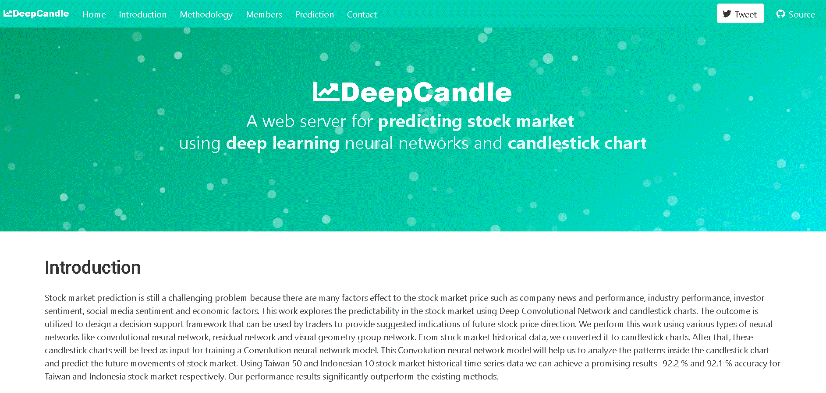
DeepCandle

Slide 45
THANKS!
😉

